Slide 1
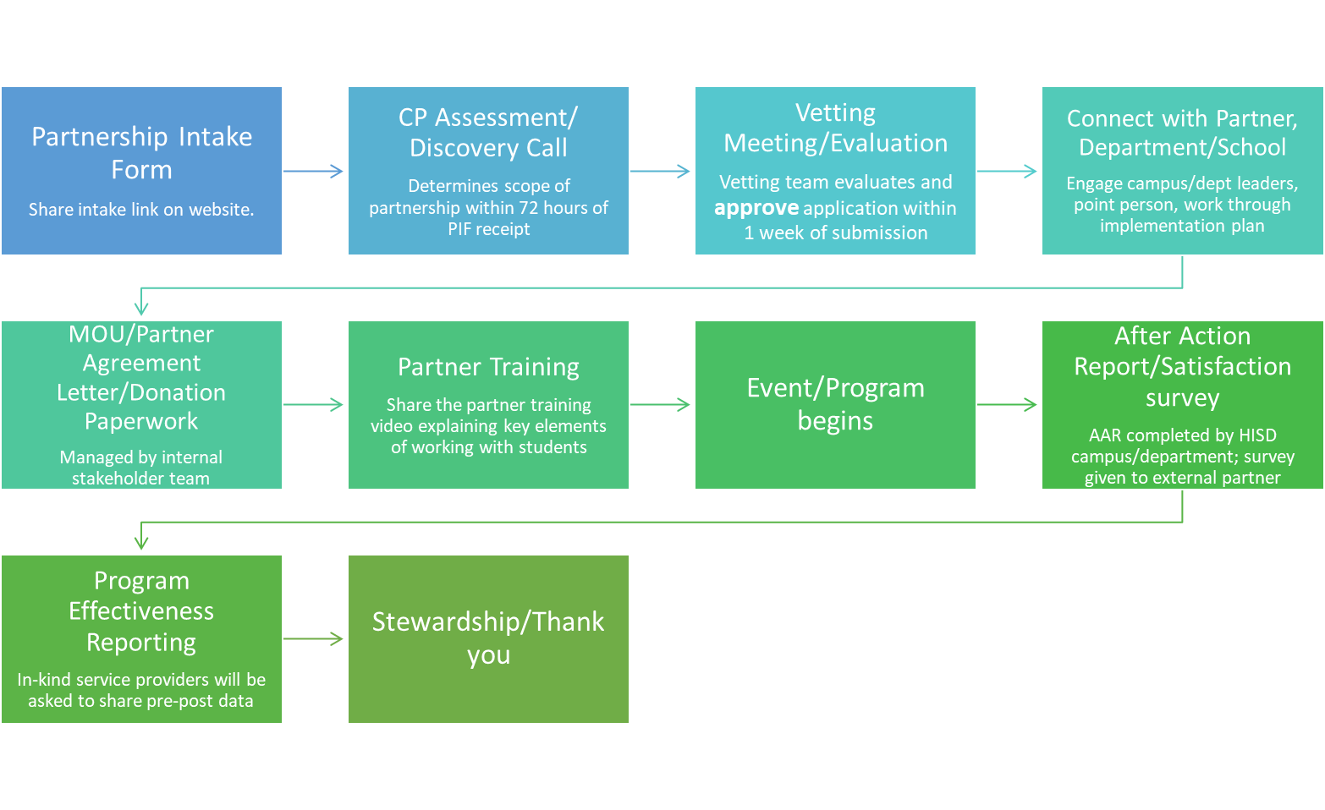
Community Partnerships Flow Chart

